Slide 1
Lecture 4
Sequential units.
Registers
Computing platforms, semester 2
Novosibirsk State University
University of Hertfordshire
D. Irtegov, A.Shafarenko
2019

Slide 2
Some terminology
Combinational units: pure logical functions.
  Output depends only on input
  No side effect (except delay)
  Can be described by single logical expression
Sequential units: have internal state
  Output depends not only on the inputs
  Input can have side-effect (changing internal state)
  Depend on timing
  Require triggers, latches and memory

Slide 3
Some final words on combinatory circuits

Slide 4
Implementing arbitrary truth table
Draw input lines. Also add inverted lines
For every row yielding 1, add AND gate and connect it to corresponding input lines (may be to inverted one)
Connect outputs of AND gates to OR gate
This is called minterm approach (normal disjunctive form)
FPGA design tools do this automatically
Optimization steps (optional)
  If table has more rows yielding 1 than 0, build device for inverted table and invert the output
  Delete unused direct or inverted input lines

Slide 5

Edge detector
One of the simplest
sequential devices
Detects input transition
from low to high
Generates pulse when
transition occurs

Slide 6
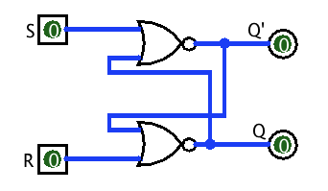
Flip-flop
Also known as Set-Reset trigger,
RS-trigger, RS-latch, etc
Detects and remembers
change in R and S signals
Edge-triggered (like edge detector)

Slide 7
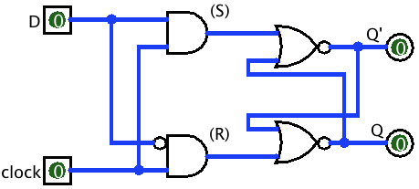
D-trigger
Remembers value of D when clock is high
When D changes on high clock, we have problem

Slide 8
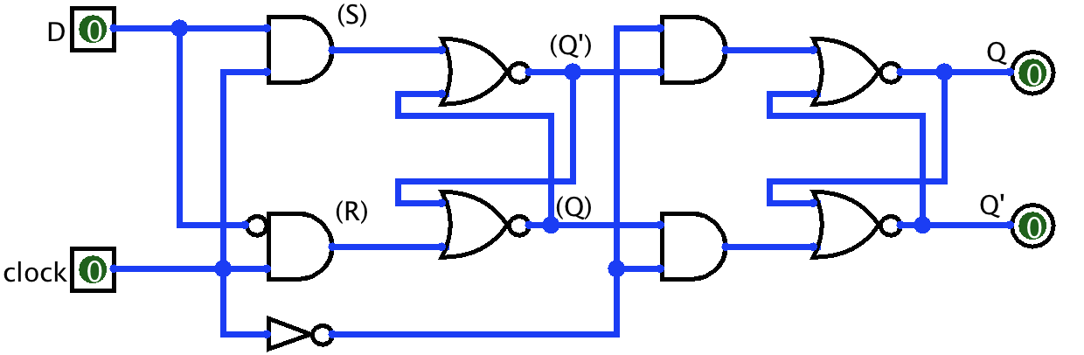
Master-slave latch
Two D-triggers connected sequentially, with inverted clock
First trigger latches D on high clock
Second trigger latches stable value of (Q) on low clock

Slide 9
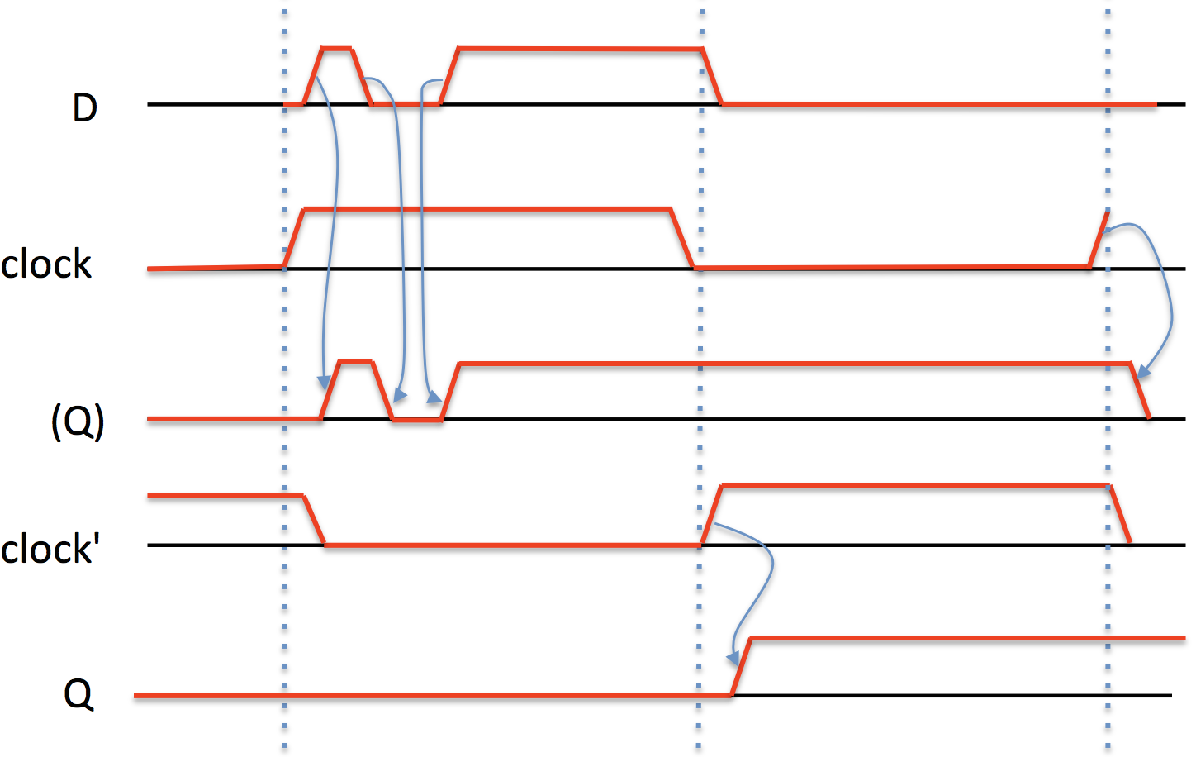
MSL timing diagram

Slide 10
Other interesting devices
Edge-triggered D-latch http://www.falstad.com/circuit/e-edgedff.html
JK-trigger http://www.falstad.com/circuit/e-jkff.html
4-bit ripple counter built on JK-triggers
http://www.falstad.com/circuit/e-counter.html
4-bit synchronous counter (simplified carry lookahead) http://www.falstad.com/circuit/e-synccounter.html
Decimal (BCD) counter
http://www.falstad.com/circuit/e-deccounter.html

Slide 11
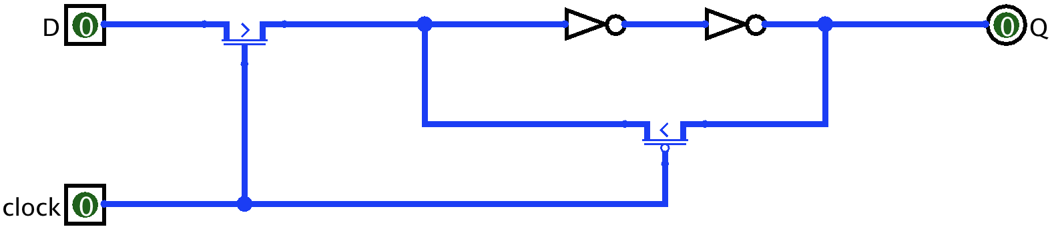
D-latch using CMOS PTL
Six transistors
The D-latch on logic gates used 22 transistors!

Slide 12
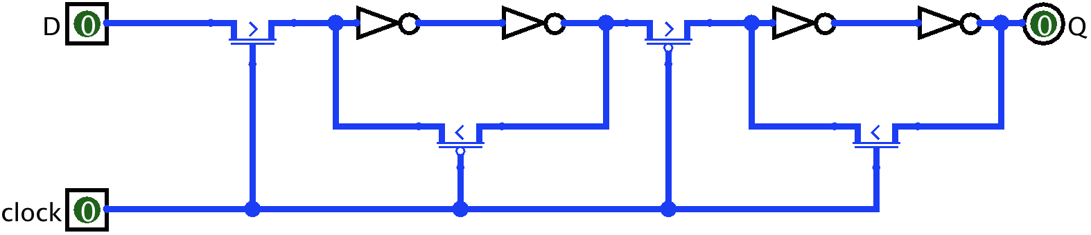
Master-slave latch on PTL

Slide 13
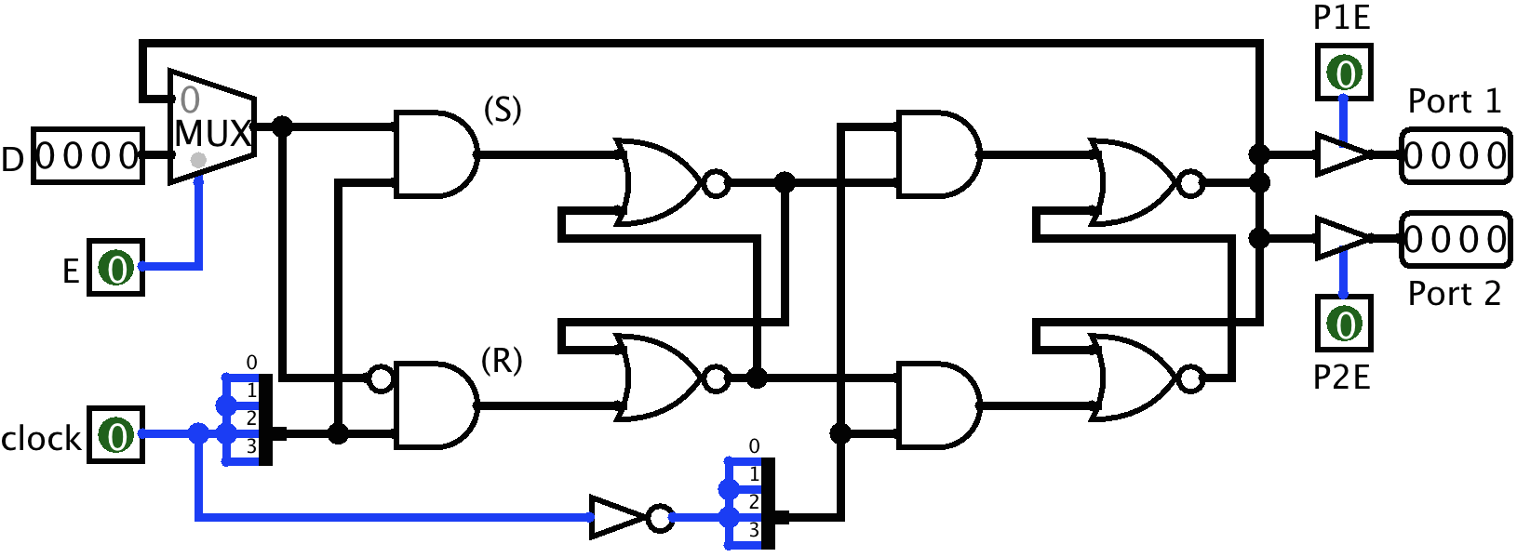
Multiported register

Slide 14
Multiport register features
Multibit storage (4 bit on previous slide)
Controlled latching. Has clock and Enable signals.
  In CdM-8, most instructions operate on a single register.
  Other registers must remain unchanged.
Multiple three-state outputs
  In CdM-8, only selected register values are needed on each clock
  Using three-state outputs, we can attach all registers to a single bus or to several buses

Slide 15
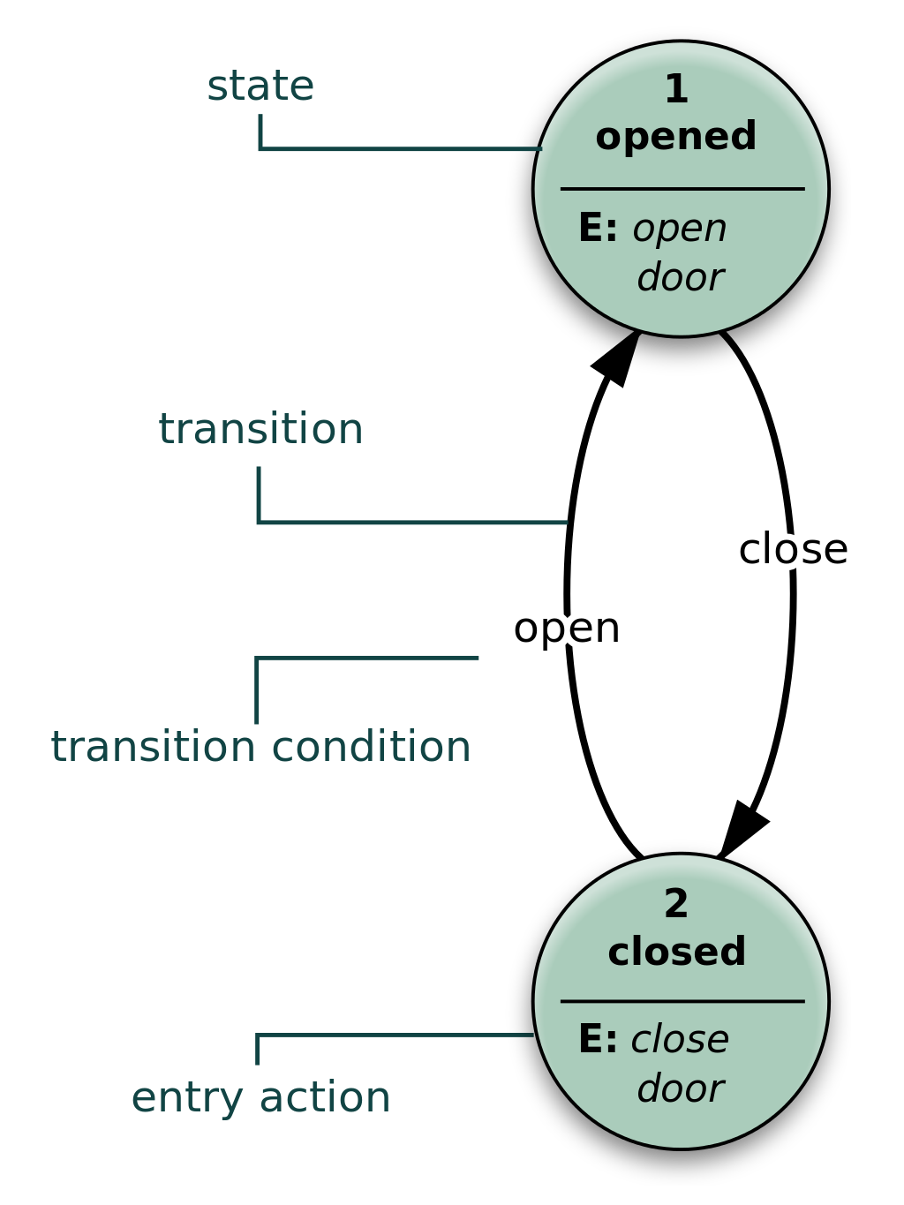
Finite state machine
A formal computation model
Used in many branches of computing
  Network protocols
  Parsers and lexers
  Event-driven programming
  Hardware design
  etc
Formally, any digital device
(including von Neumann computer)
is a Finite State Machine
Can be represented as graph of states and transitions
Can be directly implemented in hardware

Slide 16
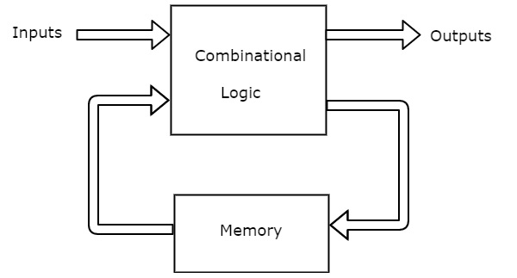
Hardware FSM

Slide 17
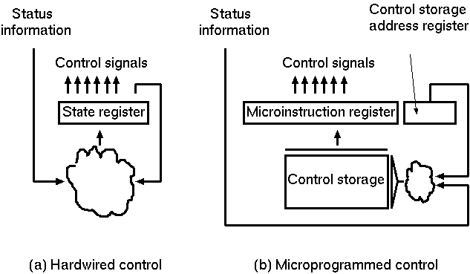
One possible next step: microprogramming

Slide 18
Microprogramming
Most modern CPU are actually microprogrammed machines
Many peripherial computer devices (those which do not have it’s own CPU inside) also are implemented as microprogrammed machines or FSM
But we won’t go into this now

